Slide 1



CAPSTONE
PRESENTATION
Data Analysis for Business Forecasting
Prof. John Fowler
ASU Team 110
Anwesha Banerjee
Sagar Pasad
Ryan Karim
Zifan Wang
Kevin Marepally

Slide 2


OUR
OBJECTIVE
Preseason forecasts are critical for planning inventory and supply chain flows. However, in-season deviations can highlight gaps in assumptions, supplier issues, or demand shifts.
This project consolidates various data sources—forecasted values, actual costs, inventory positions, and trend-based estimates—to enable cross-functional visibility and realignment of strategy.

Slide 3

METHODOLOGIES
Data
Sources
Merging
+
Cleaning
Processing
Pipeline
Performing EDA
Data
Sources
Merging
+
Cleaning
Processing Pipeline
Load forecast, inventory, actual COGS, and ZPRO data from separate CSV files into DataFrames.
Standardise column names
like MONTH, remove duplicates,
and clean overlapping columns
to prep for merge.
Merge all datasets on Brand SC
and MONTH using outer joins,
then export the final
cleaned data to a CSV file

Slide 4
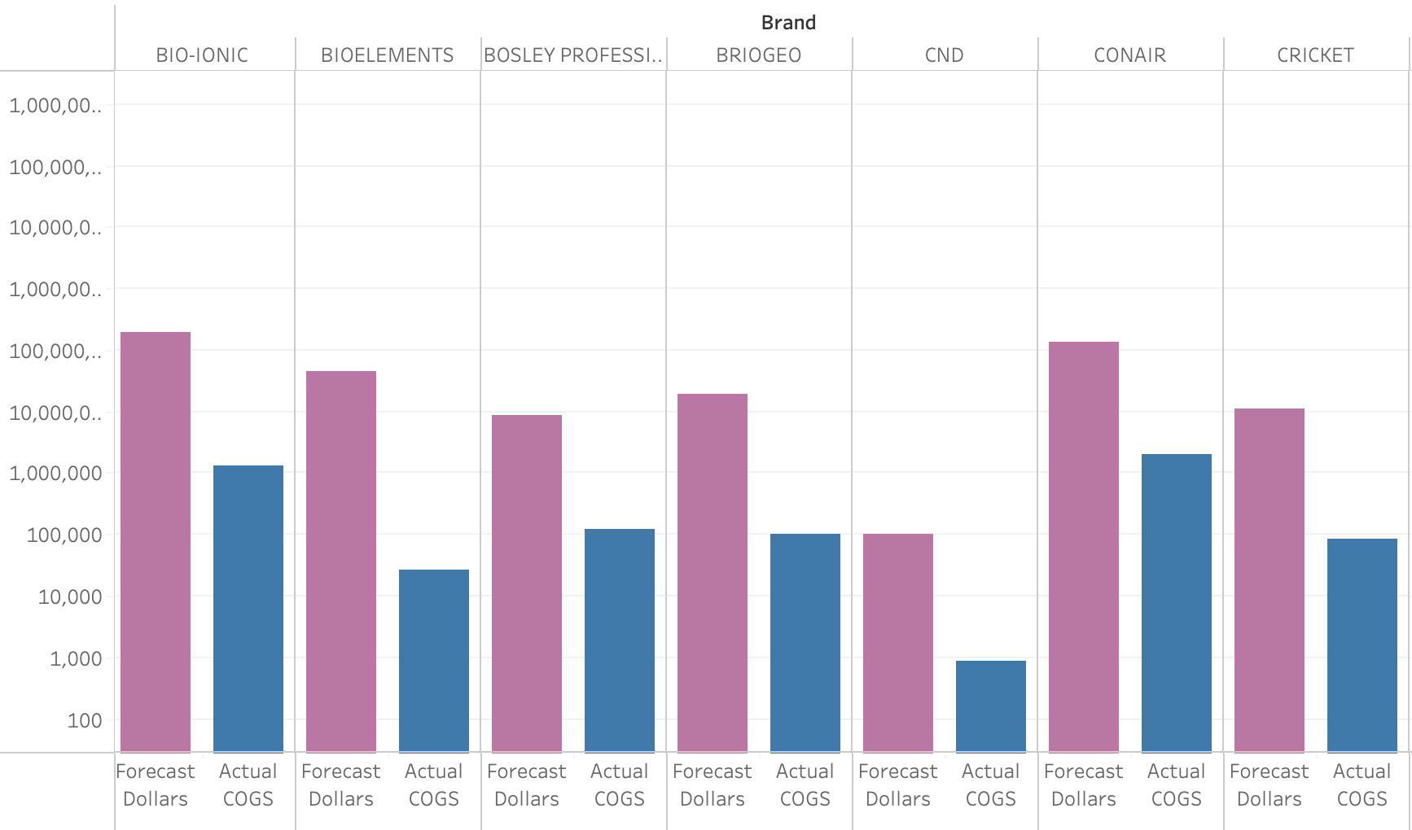
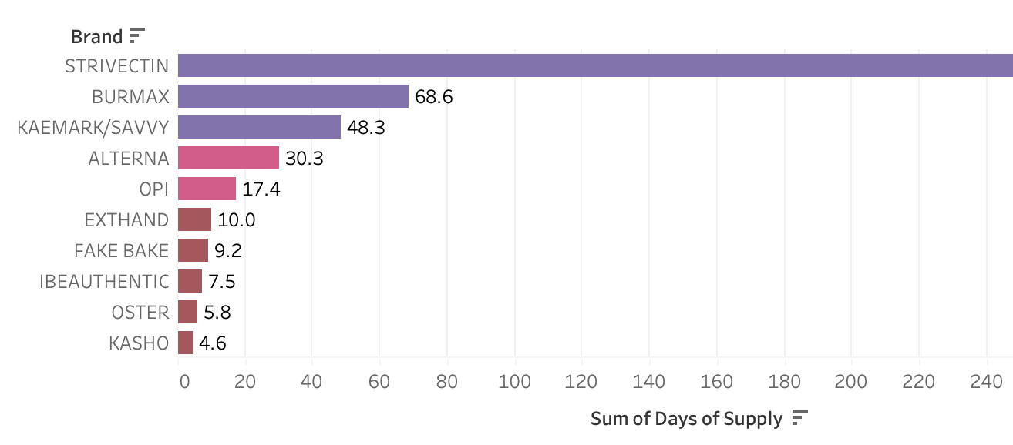
DATA ANALYSIS
Actual VS Predicted
Tracks the alignment between forecasted demand and actual units sold by Brand and Month
Highlights variances in unit performance, enabling early identification of overperformance or underperformance.
Useful for adjusting future forecasts and understanding brand
specific patterns.
A low DOS (<15 days) suggests a risk of stockout, which can lead to lost sales, customer dissatisfaction, and repetitional damage.
A high DOS (>30 days) represents a healthy inventory buffer, enabling timely fulfilment without overstocking.
Despite high forecasted units, inventory isn’t aligning — indicating either procurement delays or inventory planning mismatches.
Missing DOS data for some brands implies data integrity issues in inventory tracking systems — blind spots in supply chain visibility.
Red-Low, Pink-Medium, Purple-High(Inventory)
DOS VS Inventory

Slide 5


GAP ANALYSIS
Present
Future
Prediction
The current setup consolidates raw inventory
and forecast data but lacks actionable
insights for decision-making.
By layering analytics and interactivity,
the system evolves into a dynamic tool for smarter,
data-driven inventory planning.
Data
Sources
Merging
+
Cleaning
Processing
Pipeline
Data
Sources
Merging
+
Cleaning
Processing Pipeline
Inventory Optimisation
Modeling
Calculate EOQ, ROP, and Safety Stock using demand, cost, lead time, and variability inputs.
Enable scenario testing with interactive sliders for key parameters (Order Cost, Lead Time, MAD, Service Level).
Visualize top brands by EOQ, overlaying Safety Stock and ROP for quick decision-making.

Slide 6
APPROACH
Modeling Demand
& Uncertainty
Use MAD (Mean Absolute Deviation)
and Z-score to model demand variability
and service level expectations
Calculating Optimisation
Metrics
EOQ: Minimises the total cost of ordering and holding inventory.
ROP: Ensures replenishment happens before stockout during lead time.
Safety Stock: Buffers against demand variability and delays
Scenario Testing
with Inputs
Allow dynamic tuning of ordering cost,
lead time,
MAD, service level through interactive sliders.
This helps simulate what-if scenarios and refine planning.
Visualization for Action
Identify top 10 brands by EOQ and plot EOQ,
ROP, and Safety Stock for visual clarity.
Supports data-driven prioritization
and smarter decision-making

Slide 7
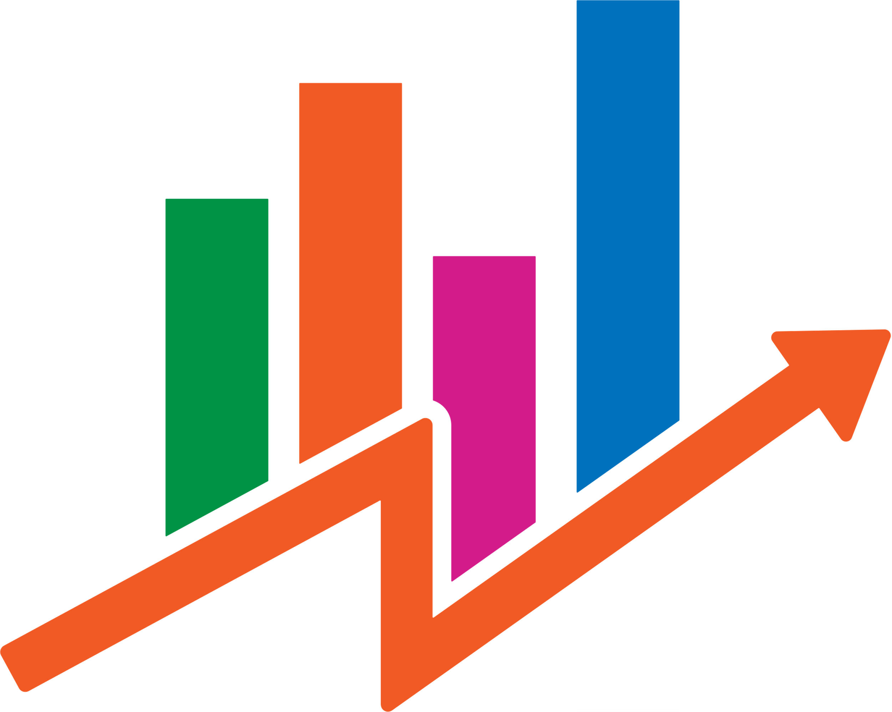
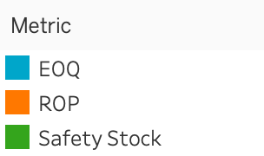
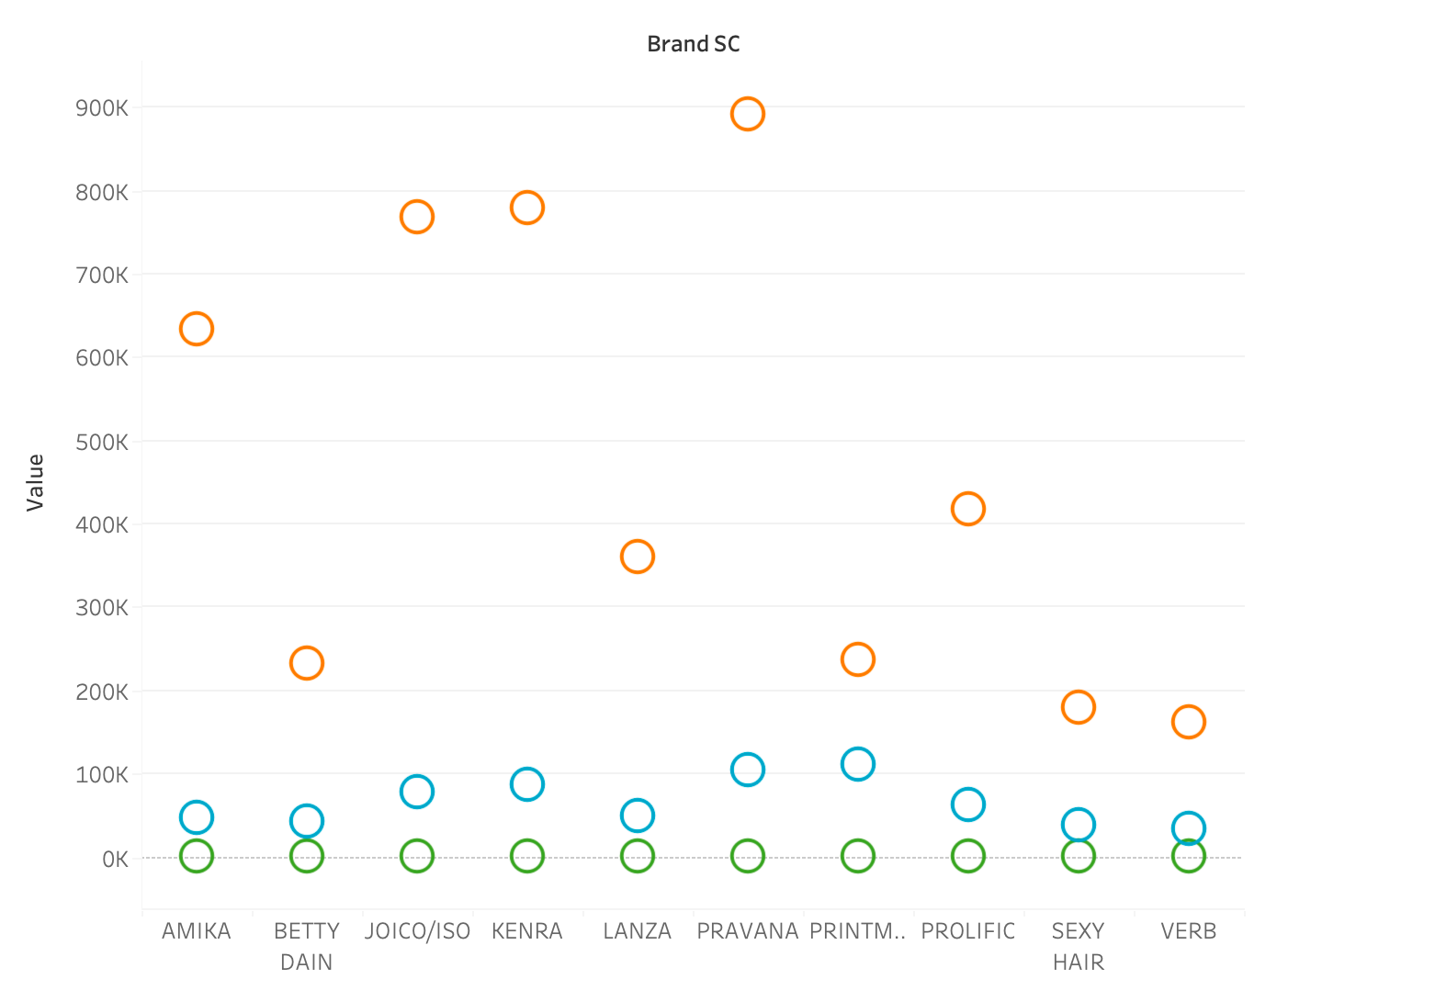
ANALYSIS
EOQ > ROP > SAFETY STOCK

Slide 8
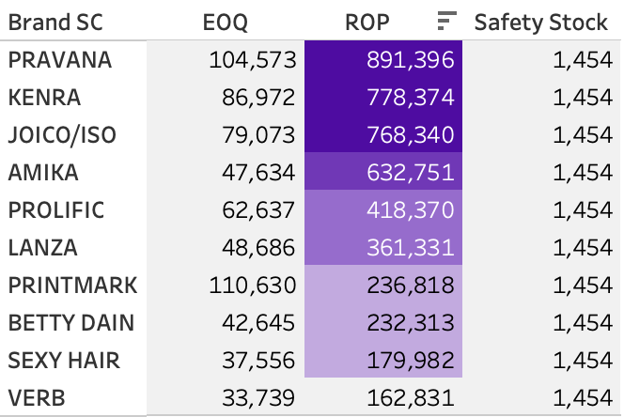
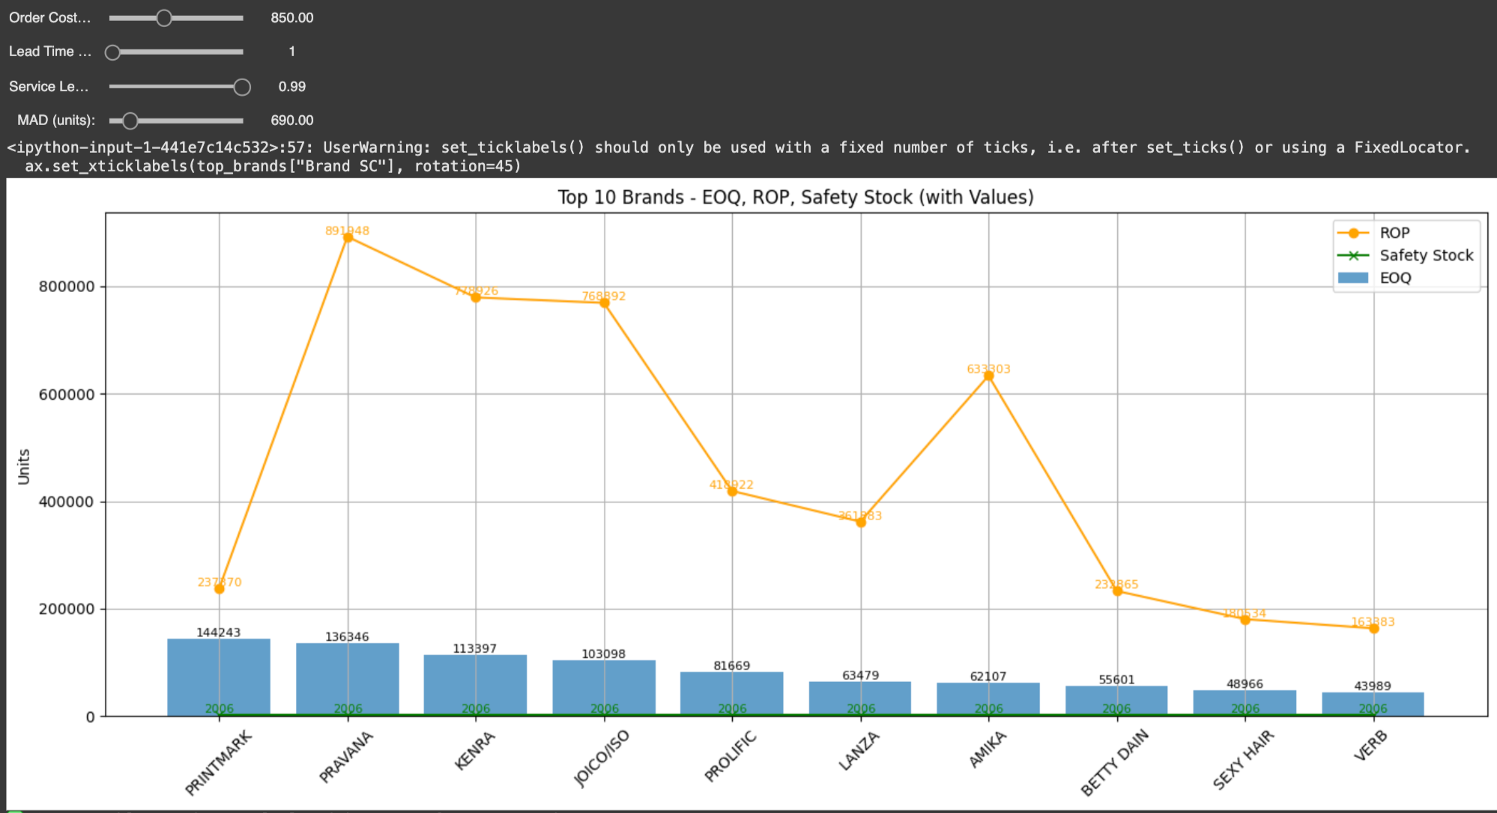
OUTCOMES
This model is a scenario-based inventory optimization tool that uses forecasted demand along with inputs like order cost, lead time, service level, and MAD to calculate key planning metrics — EOQ, ROP, and Safety Stock. It helps refine decisions once forecasts are available.
https://colab.research.google.com/drive/1ZjaWdWtrA07rmbYuPfM8hG789U4JeiJZ
This model assumes uses the following parameters:
order_cost → to calculate EOQ (optimal order quantity)
lead_time → to calculate ROP (when to reorder)
service_level + MAD → to estimate Safety Stock (protection against variability)

Slide 9
CONCLUSION
Over-forecasting → Excess stock | Match EOQ with demand to reduce holding costs
Under-forecasting → Stockouts | Adjust ROP and safety stock for reliable supply
High inventory + low DOS | Indicates inefficiency — revisit replenishment
Static safety stock for all brands | Use dynamic safety stock to reflect brand behavior
Unaligned EOQ with demand patterns | Tie EOQ to seasonality and lead time
By combining forecast, inventory, and actuals, we identified planning gaps and supply risks. Analysing DOS, EOQ, and ROP helped uncover optimisation opportunities, enabling smarter, more agile, and cost-efficient decisions.

Slide 10
FUTURE SCOPE OF PROGRESS
Past Approach
Feedback
Modeling Demand
& Uncertainty
SKU Level
Custom lead times per brand/SKU
Scenario Testing
with Inputs
Calculating Optimisation
Metrics
SKU Level Analysis done in the code
Csutomer Lead times are given in the code but need more data to built the same per brand/SKU
Visualization for Action
Scenario Testing
with Inputs
Visualization for Action

Slide 11

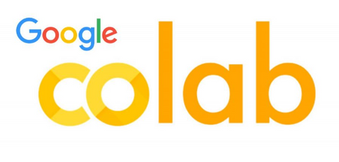
THANK YOU
Tools Used

